Slide 1
11/10/2024

Slide 2
I
PYTHON BASICS
Python for data science
WORKING WITH ARRAYS
Numpy
II
DATA SCIENCE 2 DATA & A.I. 3
IV
DATA VISUALISATION
Matplotlib
DATA ENGINEERING
pandas
III
V
MACHINE LEARNING
Automatically find patterns

Slide 3

MACHINE LEARNING
scikit-learn

Slide 4
01
WHAT IS MACHINE
LEARNING
Automatically find patterns
05
DECISION TREES
Best separating lines
INTRODUCING
SCIKIT-LEARN
Machine learning with Python
02
MACHINE LEARNING
06
K-MEANS CLUSTERING
Object grouping
HYPERPARAMETERS AND CROSS VALIDATION
Holdout samples and cross-validation
03
07
ASSOCIATION RULES
Frequent itemsets
REGRESSION
Best fitting line
04
08
ARTIFICIAL NEURAL
NETWORK
Imitate the human brain

Slide 5

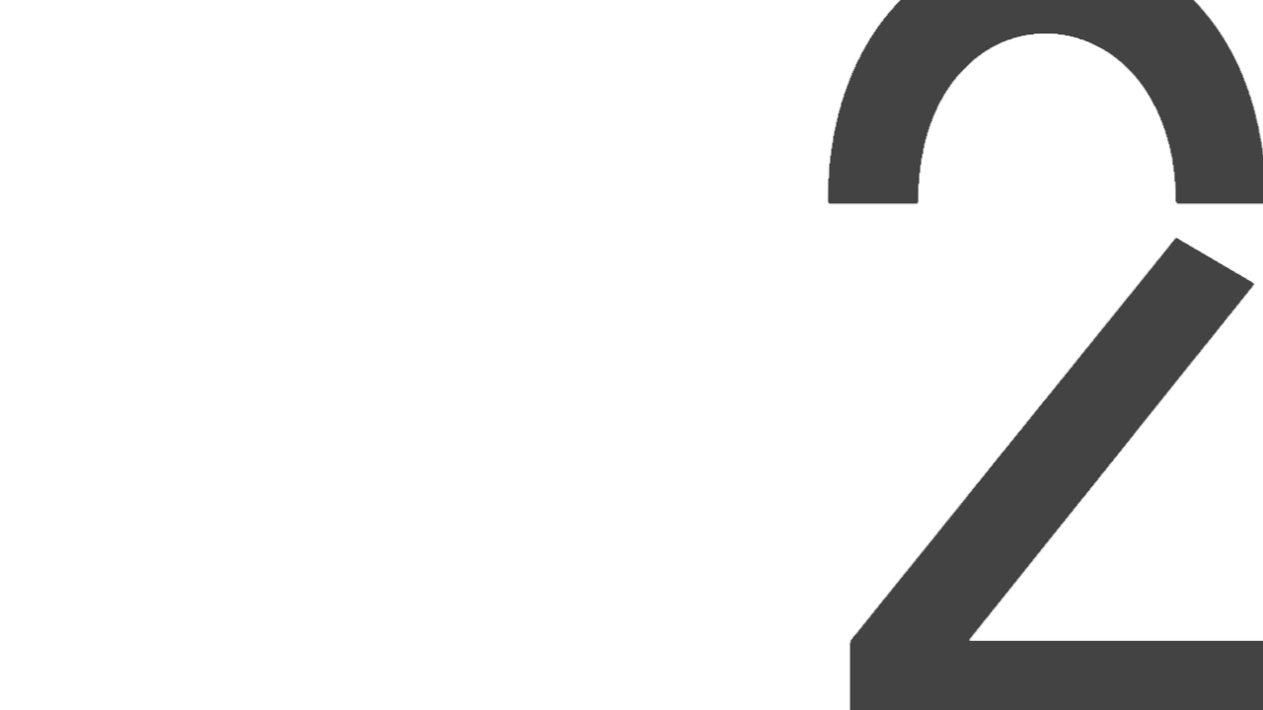

INTRODUCING SCIKIT-LEARN
Machine learning with Python

Slide 6
SCIKIT-LEARN
PYTHON PACKAGE/LIBRARY FOR MACHINE LEARNING
General purpose machine learning library (for supervised and unsupervised learning)
Very commonly used
CONSISTENT INTERFACE TO MANY MACHINE LEARING TECHNIQUES
Common methods to.
Transform data
Train model
Predict data
Validate model
=> Uniform access to many machine learning techniques
Notes:
Meest gebruikte library, api is eigenlijk onafhankelijk van welk model je kiest.

Slide 7
DATA PREPARATION
FEATURES
Supervised learning is a kind of dependency model, i.e. a model in which a feature/variable (the dependent variable) is estimated based on a series of other features/variables (independent variables)
In statistics, one talks about dependent and independent variables, in machine learning one talks about target features and predictors or independent features.
Predictors (independent features/variables) : the features that can be used to estimate the target feature
Target feature (dependent feature/variable) : the feature to be estimated
LABELED DATASET
Supervised machine learning is based on training, i.e. deriving a model based on examples, with one example being one set of predictors and the known outcome for that set of predictors. Hence, for supervised machine learning, one needs a labeled dataset, a dataset with example with for every example the known outcome (the known outcome of an example is also called a label)
So a labeled dataset contains a set of example features (dependent features or predictors) and the known outcome or label for each of
those examples.
Notes:
We moeten modellen verdelen in 2 delen, predictors gaan uitkomsten voorspellen – onafhankelijke variabelen (Denk aan de Iris datasets van vorige periode daar zouden we als predictor de lengte en grootte van de blaadjes nemen) De Target is wat we gaan voorspellen dus dan het soort bloemetje

Slide 8
DATA PREPARATION
SCIKIT-LEARN : FEATURE MATRIX AND TARGET ARRAY
X = feature matrix : the feature matrix is commonly referred to as X (capital X because it is a matrix)
y = target array : the target array is commonly referred to as y (small y because it is mostly a vector,) (capital Y if it is a matrix – for multivariate scikit)
Mind that feature matrix X must be a 2-dimensional structure or matrix in scifiit-lean, even it there is only one single feature or predictor. So in case of a single feature in a Pandas Series or a one-dimensional NumPy array, that Pandas series needs to be converted to a Pandas DataFrame explicitly, or the one-dimensional NumPy array must be converted to a two-dimensional NumPy array explicitly.
Notes:
Dit is visueel te zien 2 slides verder
Feature matrix gebruiken we een hoofdletter om duidelijk te maken dat dit 2 dimensionaal is en de output 1 dimensionaal

Slide 9
DATA PREPARATION
SCIKIT-LEARN : FEATURE MATRIX AND TARGET ARRAY
So the starting point of supervised machine learning is a labeled dataset. In scikit-learn, this labeled dataset is split into two arrays or matrices:
Feature matrix : the table with the values of the independent features or predictors. It is a table structure because it consists of rows (examples) and columns (independent features or predictors. As it is a table, it can be represented in Python by a Pandas DataFrame, or by a 2-dimensional NumPy array (matrix)
Target array : the vector with the labels, the values of the dependent features or target feature. It is mostly a vector because it contains the labels for a single target feature (one label for every example). As it is a vector, it can be represented in Python by a Pandas Series, or by a 1-dimensional NumPy array (vector). However, some scikit-learn methods can handle multile target features at once, and in that case the targe array also becomes a table that can be represented by a pandas dataframe or a 2-dimensional NumPy array (matrix)
Mind that in many cases the independent features ore predictors and the target feature are interchangeable, i.e. any feature can play the role of predictor or target.

Slide 10
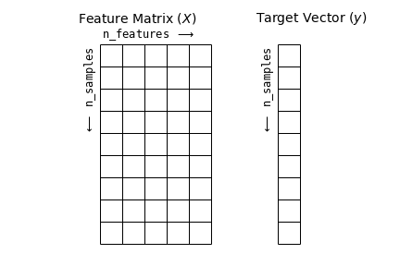
DATA PREPARATION
Notes:
Dit is visueel hoe het gebeurt, in sickik learn is de feature 2 dimensionaal featurs zijn de lijn die we als input aan het model geven (ofwel een 2 dim numpy array of een pandas serie) De input is 2 dimensionale numpy array of een pandas dataframe. De output van het model is wat we willen voorspellen. Is een 1-dimensionale numpy array of panda’s Series.
Heel belangrijk de ene is 2 dimensionaal en dan een numpy array of een dataframe de output is 1 dimensionaal dan een numpy array of panda’s Series

Slide 11
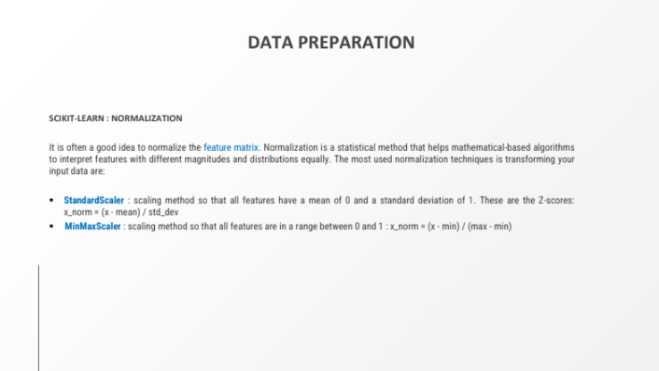
DATA PREPARATION

Slide 12
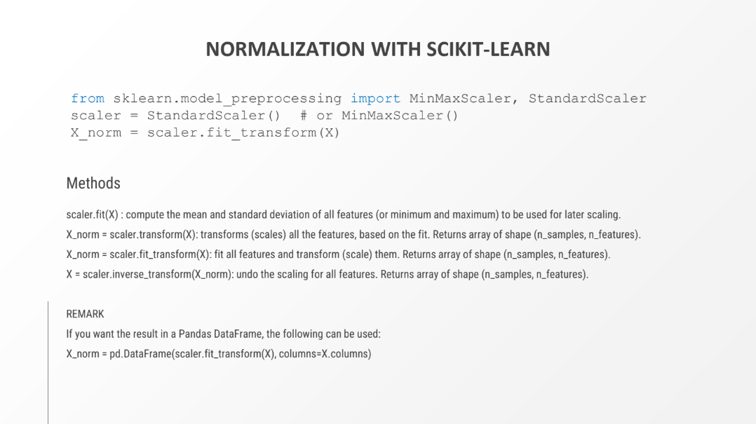
DATA PREPARATION
Notes:
BELANGRIJK als we een model trainen met geschaalde data dan zullen we wanneer we voorspellen ook alle getallen gaan schalen Dit doen we dan met de scaler.transform(X) – want we willen schalen met dezelfde schalingsfactor

Slide 13
MODEL VALIDATION BASICS (SUPERVISED LEARNING)
COMPARE PREDICTED VALUES WITH REAL VALUES (LABELS/GROUND TRUTH/GOLDEN STANDARD)
For supervised learning, model validation is easy. As you start from a labeled dataset, you have a set of examples for which you know the real outcome (labels). This is also called the ground truth or gold standard. So you can compare the predicted values with the real values (labels):
Derive (train/fit) a model based on labeled data
Use the derived model to predict the target variable in the labeled data based on the independent features/predictors in the labeled data
Compare the predicted target feature values from the previous step with the real target feature values (labels) in the labeled dataset
HOW TO COMPARE REAL AND PREDICTED VALUES FOR REGRESSION METHODS (PREDICTION OF NUMERICAL FEATURES)
Start calculating the difference between the real and predicted values. Based on those differences, validation metrics can be calculated:
MAE : mean absolute error
MAPE : mean absolute percentage error
RMSE : root mean squared error
…
Notes:
We willen kunnen weten hoe goed of slecht een model is, hiervoor gaan we scores geven.

Slide 14
MODEL VALIDATION BASICS (SUPERVISED LEARNING)
HOW TO COMPARE REAL AND PREDICTED VALUES FOR CLASSIFICATION METHODS (PREDICTION OF CATEGORICAL FEATURES)
Start compiling the confusion matrix based on the number of correctly and wrongly predicted cases. Based on this confusion matrix,
validation metrics can be calculated:
Accuracy
Precison
Recall
F-value
AUC
ROC
…
SEE DATA SCIENCE 1 / DATA & A.I. 2 AND SCIKIT-LEAN DOCUMENTATION
sklearn.metrics : https://scikit-learn.org/stable/api/sklearn.metrics.html

Slide 15
DATA ANALYTICS PIPELINE
DATA PREPARATION
Load (labeled) source data
Compile feature matrix
Compile target array (for supervised methods)
MODEL SELECTION AND HYPERPARAMETER SELECTION (MODEL SPECIFIC)
Decide on the method to use (linear regression, decision tree, K-means clustering, …)
Decide on the hyperparameter to use (degree of polynomial, tree depth, number of clusters, …) Hyperparameters are parameters that the algorithm uses to derive a model
Hyperparameters depend on the method (every methods has it’s on kind of hyperparameters)
DERIVE MODEL FROM LABELED DATA (TRAIN MODEL/FIT MODEL)
Apply the method/algorithm on the labeled data to derive the model
DISPLAY MODEL (MODEL SPECIFIC)
Display the resulting model
The resulting model depends on the method used (equation of regression line with intercept and slope, decision tree with nodes and split
conditions, groups of observations with centroid, …)

Slide 16
DATA ANALYTICS PIPELINE
VALIDATE MODEL USING LABELED DATA (SUPERVISED LEARNING)
Predict target feature for the labeled data
Calculate the difference between predicted and real values for the labeled data / calculate confusion matrix (classification)
Calculate validation metrics for the labeled data
Regression : MAE, MAPE, RMSE, …
Classification : accuracy, precision, recall, f-score, AUC, ROC
APPLY MODEL ON NEW DATA
Apply the model on new data
In case of supervised machine learning methods, this will predict the target feature for new data
In case of unsupervised machine learning methods, this will restructure the feature data (clusters, association rules, new feature matrix with reduced dimensions)

Slide 17
MODEL VALIDATION THE WRONG WAY
DO NOT TRAIN AND VALIDATE THE MODEL ON THE SAME DATA
Training and validating a model on the same data is not a good idea. It is like evaluating students based on an examination with questions that the students got beforehand, including the answers. If a student performs well on that kind of examination, you will never know whether that student really understands the questions and answers, or just learned the answers by heart.
The same problem arises with machine learning; machine learning builds a model by deriving patterns from example data. If you use the same dataset for training and validation, you will never know whether the model really captured the underlying patterns, or just learned the target value by heart for every example (e.g. a decision tree with rules that are too detailed, classifying every single example with a specific rule, instead of a limited set of general rules classifying a large set of similar cases).
OVERFITTING VERSUS GENERALISATION
Mind that the purpose of supervised machine learning is not to predict the labeled training data (you know already the outcome for that data), but to predict new data, data never seen before (and hence not included during training). That means the model should be able to generalise, i.e. be able to capture the overall patterns to be able to predict new data.
So, for validation, we are not that much interested in how well the model can predict the data used for training. We are interested in how well the model can predict new data. A model that scores well on training data but scores bad on new data is an overfitted model. That means it tries too hard to predict the training data, but is not able to grasp the general patterns in the data. It is not able he generalise, so it predicts the training data very well, but is not able to predict new data. Such a model is useless in practice.
What we need is a model that score well on new data.
Notes:
We mogen nooit een model testen met dezelfde data als waarvoor we het getraind hebben. Je moet een model testen met data die niet gebruikt is voor het trainen

Slide 18
MODEL VALIDATION THE RIGHT WAY
DO NOT USE THE LABELED TRAINING DATA FOR VALIDATION
Again, we are not interested in how well the model scores on the labeled training data, but on new data. That means that the labeled training data
MUST NOT be used for validation. Hence, after training, a new labeled dataset needs to be constructed for the validation.
Constructing a new labeled dataset after training is not a practical approach; constructing a labeled dataset might require expert knowledge in the domain at hand. As a data scientist, you cannot have expert knowledge for every potential domain. So labeling a dataset might require external experts. It is not always possible to call those in after every training job.
The solutions is to find a way to use the labeled dataset for both training and validation.
USE A HOLDOUT SAMPLE FOR VALIDATION
The answer to that problem is to use a holdout sample. That means that some labeled examples are set aside before training and are not used during training. After training, the holdout sample, i.e. the labeled examples that were set aside and not used in training, can now be used for an independent validation as they are new to the model.
SPLIT LABELED DATA INTO TRAINING SET AND TEST SET
In practice, it is as simple as to split the labeled data set in two subsets, one subset to be used for training, and one subset to be used for testing (validation).
The split does not need to be 50/50. The more training examples the better, but of course there need to be enough test examples to get a representative sample for testing. Common ratio’s are 70%/80% for training and 30%/20% for testing.

Slide 19


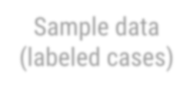

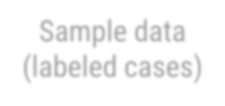


TRAIN - TEST SPLIT
Take part of the data to train model
Sample data (labeled cases)
Sample data (labeled cases)
Take another part of the data to test model
Sample data (labeled cases)

Slide 20
TRAIN – TEST SPLIT WITH SCIKIT-LEARN
from sklearn.model_selection import train_test_split
X_train, X_test, y_train, y_test = train_test_split(X, y, train_size=0.8)
Parameters
X , y : feature matrix and target vector (more general: can be any number of NumPy or Pandas DataFrames, but they all need to have the same length)
test_size :
Default: complement of train_size, if train_size is also None: 0.25
int: number of test samples
float: proportion of test samples (should be between 0.0 and 1.0)
train_size :
Default: complement of test_size
int: number of trainingt samples
float: proportion of training samples (should be between 0.0 and 1.0)
shuffle (default=True): whether or not to shuffle the data before splitting
Returns
X_train, X_test, y_train, y_test: splitted Numpy arrays of Pandas DataFrames (more general: 2 times the number of arrays given as input)
Notes:
Voor het opsplitsen kunnen we een functie gebruiken welke we moeten importeren 90/10 is een veilige hoeveelheid
Hier nemen we de train-size een grootte, we zouden ook de test-size kunnen zetten, maakt niet veel uit
Als we intigers gebruiken zijn het absolute waarden. Bij floating moet het tussen 0 en 1 liggen
Shuffle staat by-default altijd op true, zal de dataset eerst schudden voor hij traint

Slide 21
MODEL VALIDATION BASICS (UNSUPERVISED LEARNING)
METHOD SPECIFIC
For unsupervised learning (clustering, dimensionality reduction, association rules), model validation is not easy. There are no labels to compare with, there is no ground truth or golden standard.
The way to validate this is very method specific.
Some methods allow to derive some metrics that can be used in validation:
Clustering : Inter cluster distance (should by high), intra cluster distance (should be low), silhouette (should be high)
Association rules : lift, confidence
MIND VALIDATION METRICS AS THESE ARE USED TO DERIVE THE MODEL
Do not blindly rely on validation metrics of unsupervised methods, as these metrics are used under the hood to derive the model:
Clustering : inter cluster distance and intra cluster distance is used to form the clusters
Association rules : lift and confidence are used to select relevant rules
Using these metrics for validation of unsupervised models is a bit like using training data to validate supervised models. If unsupervised models score low on those metrics, you can be sure the model is bad, but the opposite is not true, if unsupervised models score high on those metrics, you still can not know for sure the model is good.

Slide 22
MODEL VALIDATION BASICS (UNSUPERVISED LEARNING)
THE PROOF OF THE PUDDING IS IN THE EATING
The only way to check whether an unsupervised model is good is to implement it and check if it does the job that has to be done, or solve the problem it has to solve. That kind of validation can be very hard and time consuming.

